Slide 1
Changing Your Raiser’s Edge Connection
Directions for altering existing Remote Desktop Connection settings for both Windows and Mac computers
7/6/16

Slide 2
A Few Things Before We Get Started
Make sure you have logged out from the Remote Desktop before updating the connection.
Make sure you have transferred data you saved in the Beyond Nines environment to your local machine, either via Dropbox or copy/paste.

Slide 3
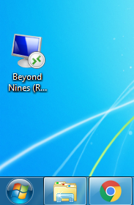
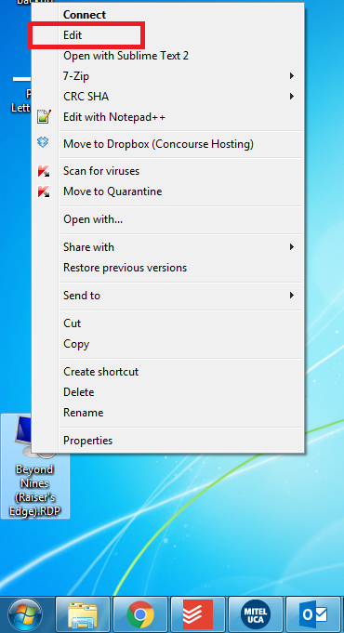
To update the Remote Desktop Connection on PC:
Locate the icon (most likely on your desktop) that matches the picture to the right. It may be labeled Raiser’s Edge,
Beyond Nines, or a combination of the two.
Right click the icon, and choose edit, near the top of the pop-up menu.

Slide 4
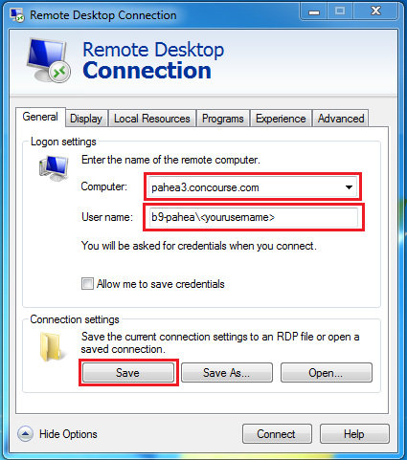
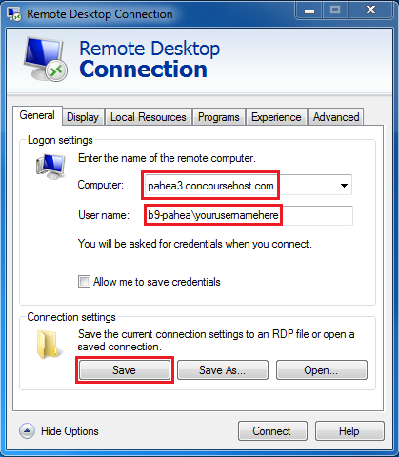
In the General tab:
Change the connecting computer from pahea.beyondnines.com to pahea3.concoursehost.com
Make sure your user name is still preceded by b9-pahea\
Click the Save button in the lower left
You can now close this window, or click connect to launch the connection

Slide 5
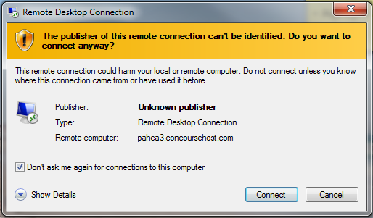
To finish connecting:
You will be prompted to confirm the connection.
Before clicking “Connect” in the lower right corner, make sure to mark the “Don’t ask me again for connections to this computer” check box in the lower left.

Slide 6
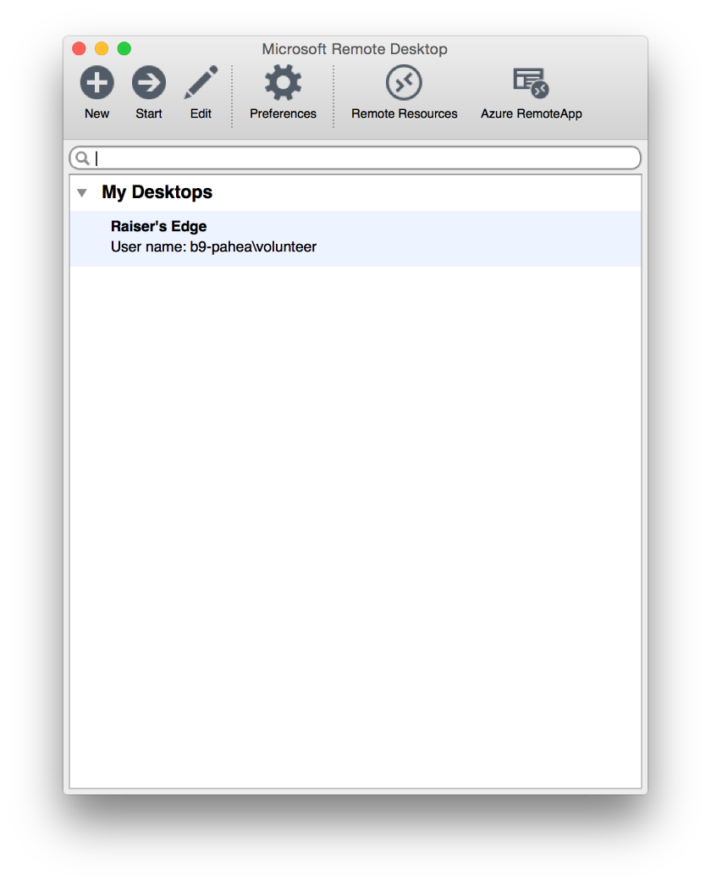
Changing Remote Desktop Connection settings for Macs:
Launch the Remote Desktop Connection App
Select the desktop you wish to edit (most likely labeled Raiser’s Edge) and click the edit button at the top.

Slide 7
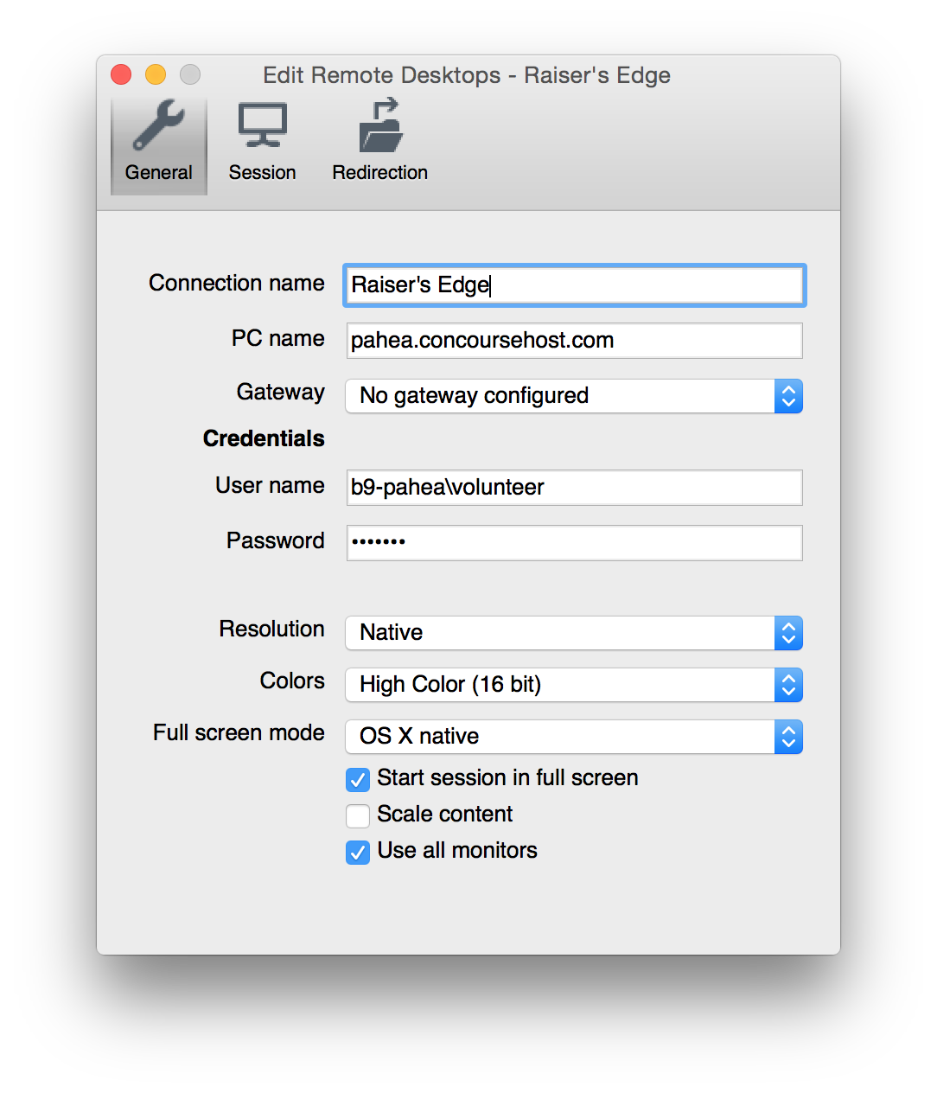
In the General tab:
Change the PC name from pahea.beyondnines.com to pahea3.concoursehost.com
Make sure your user name is still preceded by b9-pahea\
Make sure to leave the Password field blank
Close the window. The changes will save automatically.

